Slide 1
Image Noise Removal
Digital Signal Processing
Group No: 7

Slide 2
Workflow
TAKE A COLOURED IMAGE (225 X 225)
CONVERT IT INTO A GREYSCALE
MADE DIFFERENT IMAGES WITH NOISE
AVERAGING OUT NOISE
OBTAINED NOISE FREE IMAGE

Slide 3
Filter and Noise Used
Type of Noise: Gaussian Noise, Salt and Pepper Noise, Gamma Noise
Type of Filters: Mean Filter, Median Filter
We used Gaussian Noise and Mean Filter

Slide 4
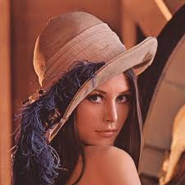
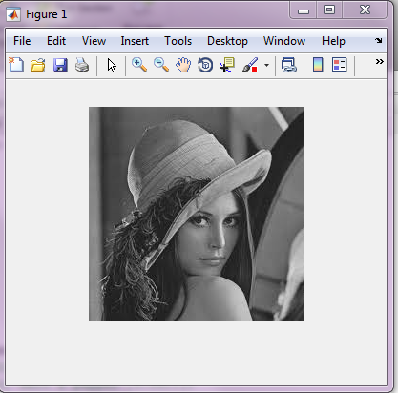
Image Used

Slide 5
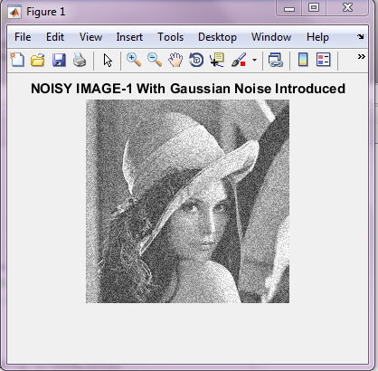
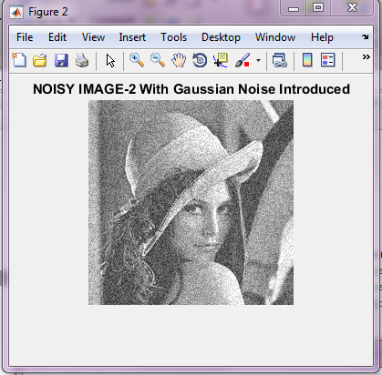
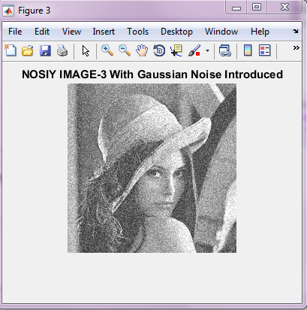

Slide 6
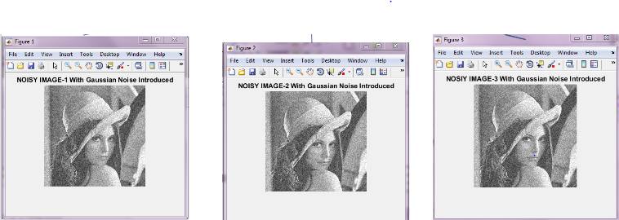
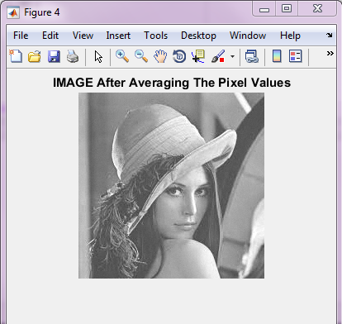

Slide 7
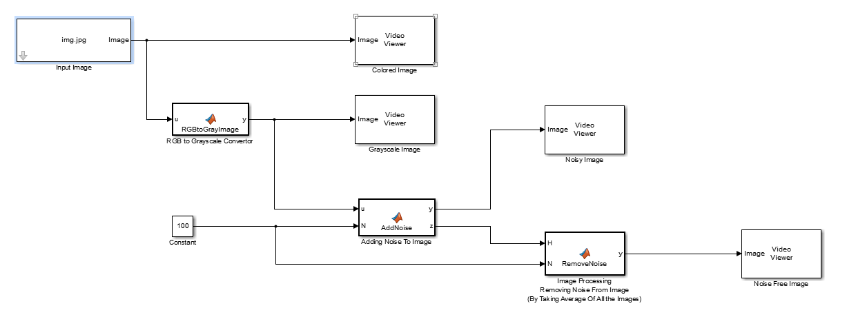
Simulink Model

